Slide 1
BSCSIT
Statistics I
Course Overview
Santosh Chhatkuli
Lecturer of Statistics
Department of Computer science
Amrit science college

Slide 2
Course
Course title: Statistics I
Course Code: STA 164
Credit Hour: 3
Nature of Course: Theory (3 Hours) + Lab (3 Hours)
Course Option: Elective

Slide 3
Course Evaluation
Component F.M. P.M.
TU Board Examination 60 24
Practical Test + Viva 20 8
Internal Evaluation 20 8
---------------------------------------------------------
Total 100 40

Slide 4
TU Board Examination
There are two question groups:
Group A (Long questions group)
Group B (Short questions group)
Two questions from group A and eight questions from group B have to be solved. Each long question carries 10 marks and each short questions carries 5 marks.
2 x 10 = 20
8 x 5 = 40
----------------
Total = 60

Slide 5
Practical Examination
Practical exam is held after TU board examination. Practical exam carries 20 marks. It is evaluated by following way.
Lab test using statistical software 10
Viva 5
Statistical Practical 5
------------------------------------------------------
Total 20

Slide 6
Internal Evaluation
Internal evaluation carries 20 marks and it has following breakdown of marks.
First Term Examination 2
Second Term Examination 4
Sent up Examination 8
Assignment 2
Attendance/Class Behavior 2
Presentation 2
-------------------------------------------------------------
Total 20

Slide 7
Course Content
This course has seven units. The units are:
Unit 1: Introduction to Statistics (4)
Unit 2: Descriptive Statistics (6)
Unit 3: Introduction to probability (8)
Unit 4: Sampling (3)
Unit 5: Random Variable and Mathematical Expectation (5)
Unit 6: Probability Distributions (12)
Unit 7: Correlation and Regression (7)
Total Lecture Hours = 45 (Prescribed by TU)
Expected Lecture Hours = 70

Slide 8
Suggested Book
Michael Baron (2013), Probability and Statistics for Computer Scientists, 2nd Ed., CRC Press
Ronald E. Walpole, Raymond H. Myers, Sharon L. Myers and Keying Ye (2012), Probability and Statistics for Engineering and Scientists, 9th Ed., Wiley
Douglas C. Montgomery and George C. Ranger (2003), Applied Statistics and Probability for Engineers, 3rd Ed. Wiley
Richard A. Johnson (2001), Probability and Statistics for Engineers, 6th Ed., Pearson Education

Slide 9
Contact Me
Email: schhatkuli@gmail.com
Phone: 9841486551
Webpage: https://sites.google.com/site/schhatkuli/
Google Form: https://tinyurl.com/y5rcpf47
.Software Download Link
Minitab: https://tinyurl.com/yyndvghb
IBM SPSS: https://tinyurl.com/mrxx52ux
Recommended Books
https://tinyurl.com/yyeoxt66
https://tinyurl.com/y5gaj8d9

Slide 10
Application areas of statistics in computer science
Simulation and modelling: Computer simulation, the use of a computer to represent the dynamic responses of one system by the behavior of another system modeled after it. A simulation uses a mathematical description, or model, of a real system in the form of a computer program.
Artificial Intelligence: The theory and development of computer systems able to perform tasks normally requiring human intelligence, such as visual perception, speech recognition, decision-making, and translation between languages.
Statistics and machine learning : Machine Learning is a sub-area of artificial intelligence, whereby the term refers to the ability of IT systems to independently find solutions to problems by recognizing patterns in databases. In other words: Machine Learning enables IT systems to recognize patterns on the basis of existing algorithms and data sets and to develop adequate solution concepts. Therefore, in Machine Learning, artificial knowledge is generated on the basis of experience.
Tasks by Machine Learning:
Finding, extracting and summarizing relevant data
Making predictions based on the analysis of data
Calculating probabilities for specific results
Adapting to certain developments autonomously
Optimizing processes based on recognized patterns

Slide 11
Computational Statistics: Computational statistics, or statistical computing, is the interface between statistics and computer science. It is the area of computational science specific to the mathematical science of statistics.
Data Mining: Data mining is a process of discovering patterns in large data sets involving methods at the intersection of machine learning, statistics, and database systems
Data Warehousing: A Data Warehousing (DW) is process for collecting and managing data from varied sources to provide meaningful business insights. A Data warehouse is typically used to connect and analyze business data from heterogeneous sources. The data warehouse is the core of the BI system which is built for data analysis and reporting.
Neural Network: Neural networks are being used in areas of prediction and classification, the areas where statistical methods have traditionally been used.

Slide 12
Web Analytic: Web analytics is the measurement, collection, analysis and reporting of web data for purposes of understanding and optimizing web usage
Visual Analytics: Visual Analytics is the science of analytical reasoning supported by interactive visual interfaces.
Test Analytics: Text analytics is the automated process of translating large volumes of unstructured text into quantitative data to uncover insights, trends, and patterns. Combined with data visualization tools, this technique enables companies to understand the story behind the numbers and make better decisions.
Business Analytics: Business analytics is the process of collating, sorting, processing, and studying business data, and using statistical models and iterative methodologies to transform data into business insights. The goal of business analytics is to determine which datasets are useful and how they can be leveraged to solve problems and increase efficiency, productivity, and revenue.
Design and analysis of algorithm: Design and Analysis of Algorithm is very important for designing algorithm to solve different types of problems in the branch of computer science and information technology.
Data Structure and Algorithms: A data structure is a named location that can be used to store and organize data. And, an algorithm is a collection of steps to solve a particular problem. Learning data structures and algorithms allow us to write efficient and optimized computer programs.

Slide 13
Computer performance/Hardware Bench-marking: Benchmarking is usually associated with assessing performance characteristics of computer hardware, for example, the floating point operation performance of a CPU
Software performance/Software Bench-marking: One of the most important things that a business who relies on software development can do is to establish a software performance benchmarking system. This is used to determine how a system performs when tested under a particular workload. It can test stability, responsiveness, effectiveness, speed or something else. It can also be used to investigate, measure, validate or verify other parts of your code, such as the scalability or usage.
Manufacturing and Quality Control: Statistical process control is a method of quality control which employs statistical methods to monitor and control a process. This helps to ensure that the process operates efficiently, producing more specification-conforming products with less waste.
Bioinformatics: Bioinformatics involves the integration of computers, software tools, and databases in an effort to address biological questions. Bioinformatics and computational biology involve the analysis of huge biological data, particularly DNA, RNA, and protein sequences.
Stochastic process and queuing theory: The word stochastic is jargon for random. A stochastic process is a system which evolves in time while undergoing chance fluctuations. Queueing theory is the mathematical study of waiting lines, or queues. A queueing model is constructed so that queue lengths and waiting time can be predicted.

Slide 14
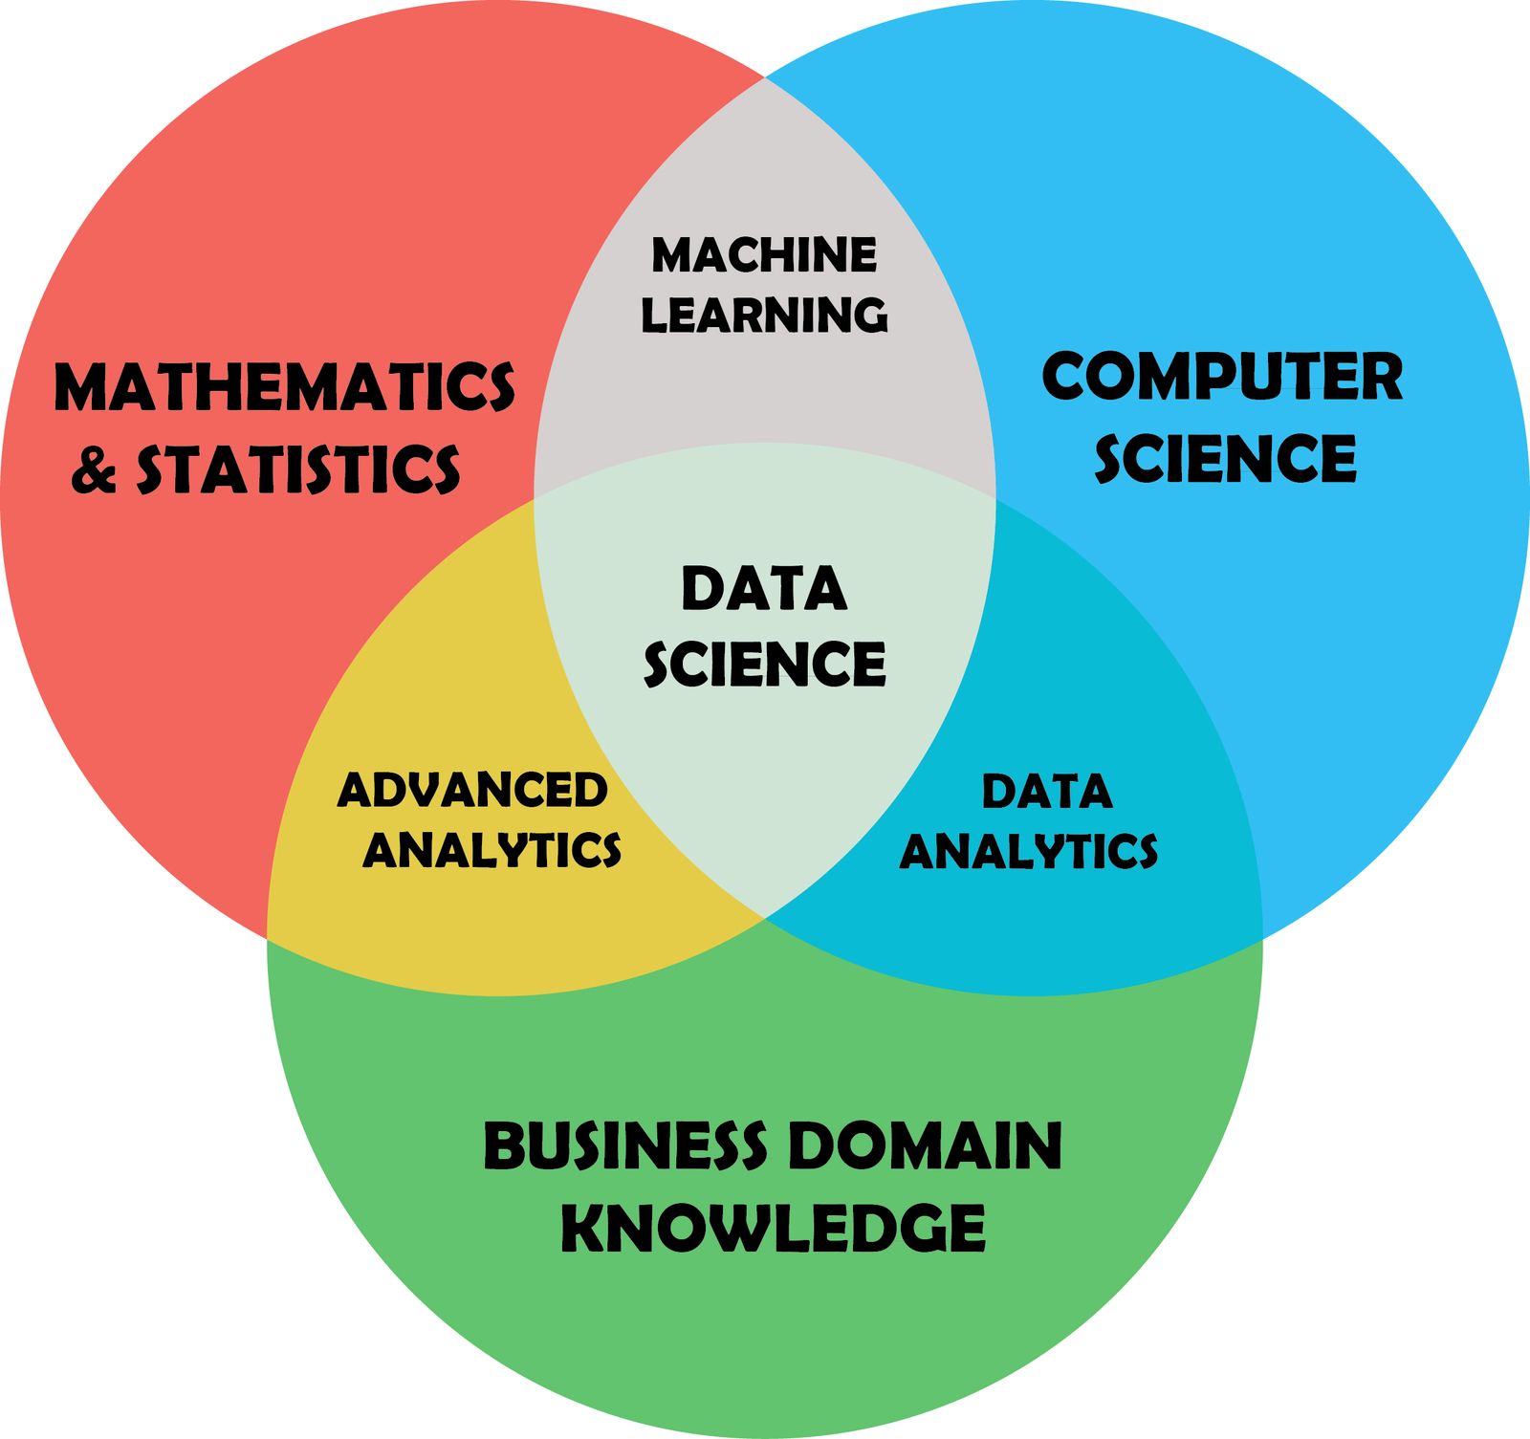

Slide 15
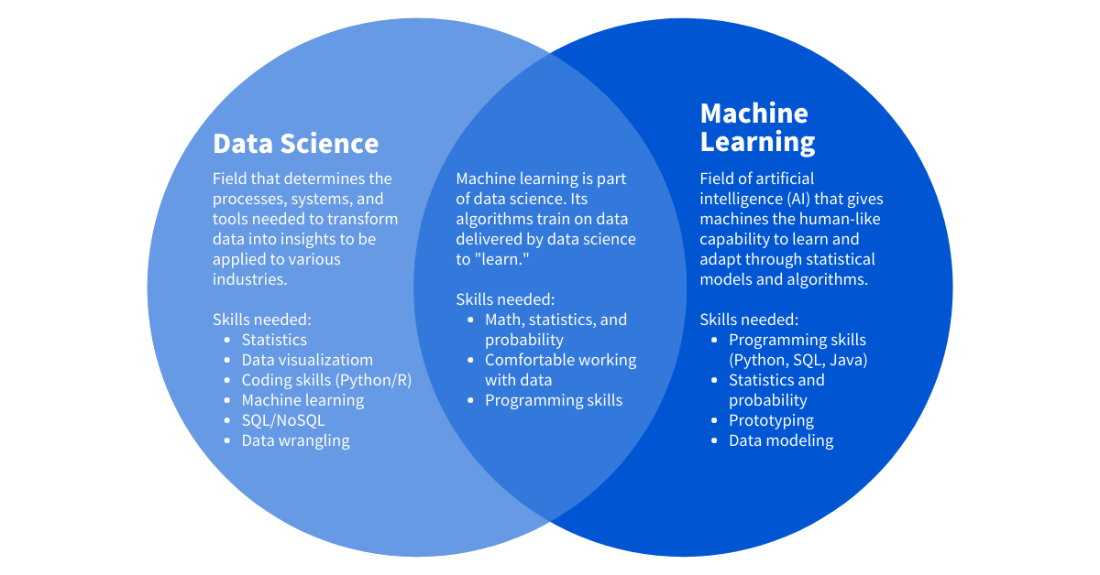
Data science studies data and how to extract meaning from it, whereas machine learning is a field devoted to understanding and building methods that utilize data to improve performance or inform predictions. Machine learning is a branch of artificial intelligence.

